Slide 1
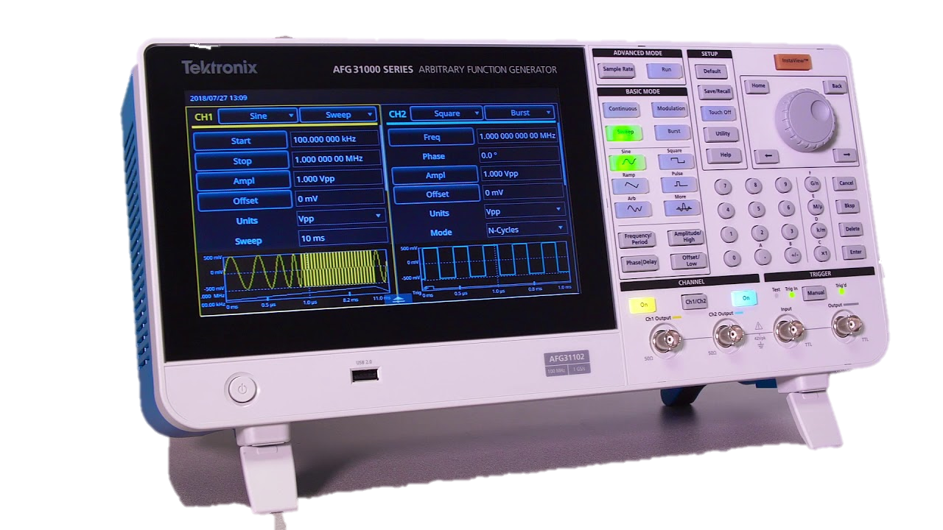
Function Generator
Presented by-
M. AASHRITH
SD. ASLAM
B. AJAY KUMAR
23EEB0B03
23EEB0B15
23EEB0B24

Slide 2
Introduction
Function generator is an electronic device which generates various types of electrical waveforms over a broad range of frequencies. These devices can be used to generate waves with variable frequencies, amplitudes, offsets, and duty cycles for various experimental design purposes.

Slide 3
Design Specifications
Function generator should be able generate sine, square, sawtooth, and triangular waves.
The output frequency should be variable from 20 Hz to 20000 Hz.

Slide 4
Allocation of tasks
M.AASHRITH– Sine wave generation and simulation
S.D.ASLAM – Triangle and Sawtooth wave generation
B. AJAY KUMAR– Square wave generation and power circuit

Slide 5
Circuit Components
OP-AMP (741)
Resistors
Capacitors
Variable Resistors
Diodes
Voltage Regulators
Step-down Transformer (18V)
Rectifier Bridge
Oscilloscope
Switches (single & double tap)
Potentiometers

Slide 6
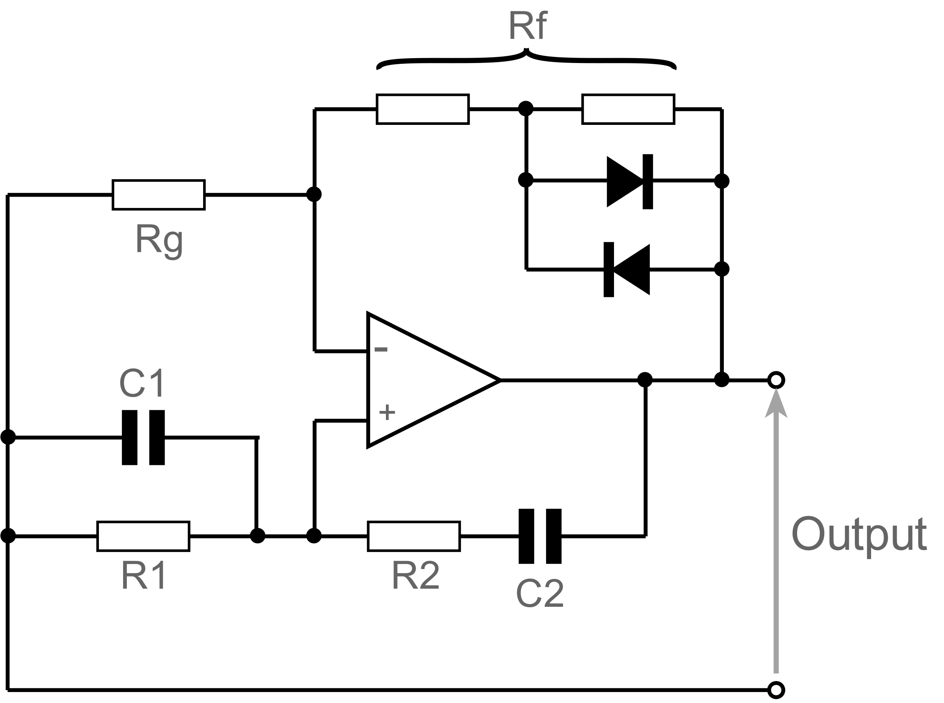
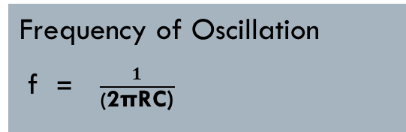
Sine Wave Generation
Wein Bridge Oscillator circuit
A positive gain amplifier combined with a bandpass filter
It is necessary to be able to limit the gain
C1 = C2 and R1 = R2( Rf is typically set to be 2 Rg )
A pair of back to back diodes in the oscillator feedback loop is used to reduce the distortion
At the resonant frequency, the reactance of the overall circuit equals its resistance, Xc = R, and the phase difference between the input and output is zero
Frequency of Oscillation
f = $\frac{1}{\text{(}\text{2}\text{πRC}\text{)}}$

Slide 7
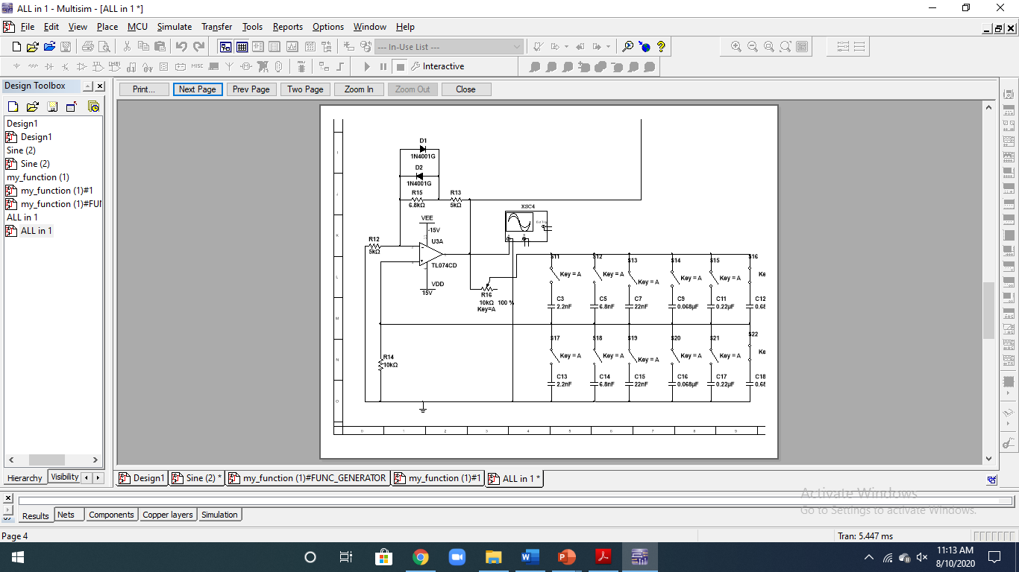

Slide 8
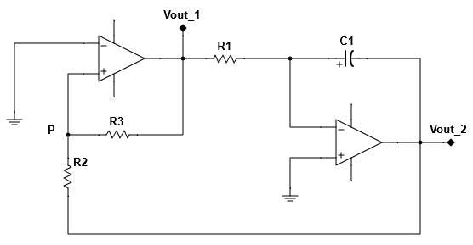
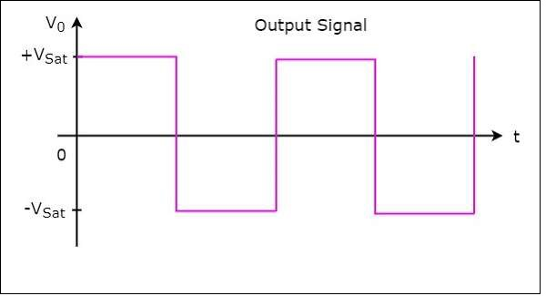
Square wave generation
V1 = Inverting terminal Voltage
VP = Non-inverting terminal Voltage
Vid =VP – V1
If VP > 0 Vid > 0 VOUT_1 = +Vsat
If VP <0 Vid > 0 VOUT_1 = -Vsat

Slide 9

When VOUT_1 >0, VOUT_1= +Vsat,
VOUT_2 = -Vramp
So that at a certain point Vp becomes 0.
When VOUT_1 <0, VOUT_1= -Vsat,
VOUT_2 = +Vramp
F = $\frac{R3}{4×R1×R2×C1}$
Frequency is changed by using R1 potentiometer and set of capacitors for C1

Slide 10
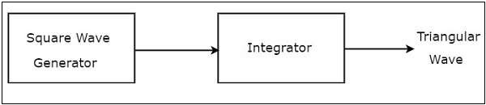
Triangular wave generation
The output of square wave generator circuit is applied as the input of integrator.
Frequency can be changed in the same way as the in square wave generator.

Slide 11
Sawtooth WAVE GENERATION
Sawtooth waveform is generated by modifying the triangular wave generation circuit.
The non-inverting output of the op-amp is set to a potentiometer.
When the voltage of potentiometer decreases – rise time> fall time
increases – rise time< fall time

Slide 12
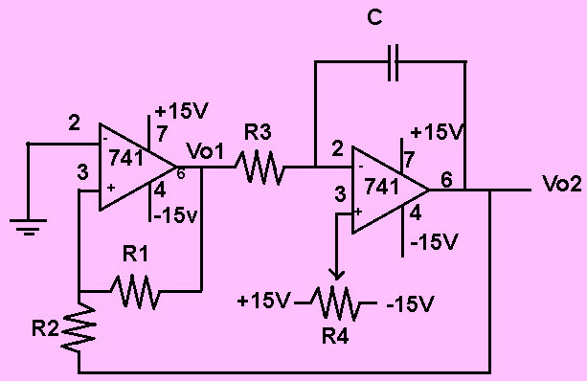
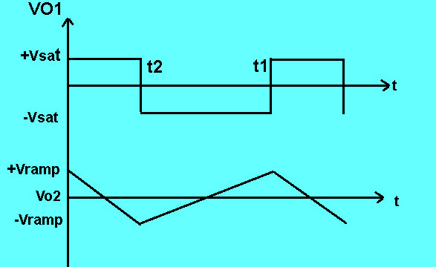

Slide 13
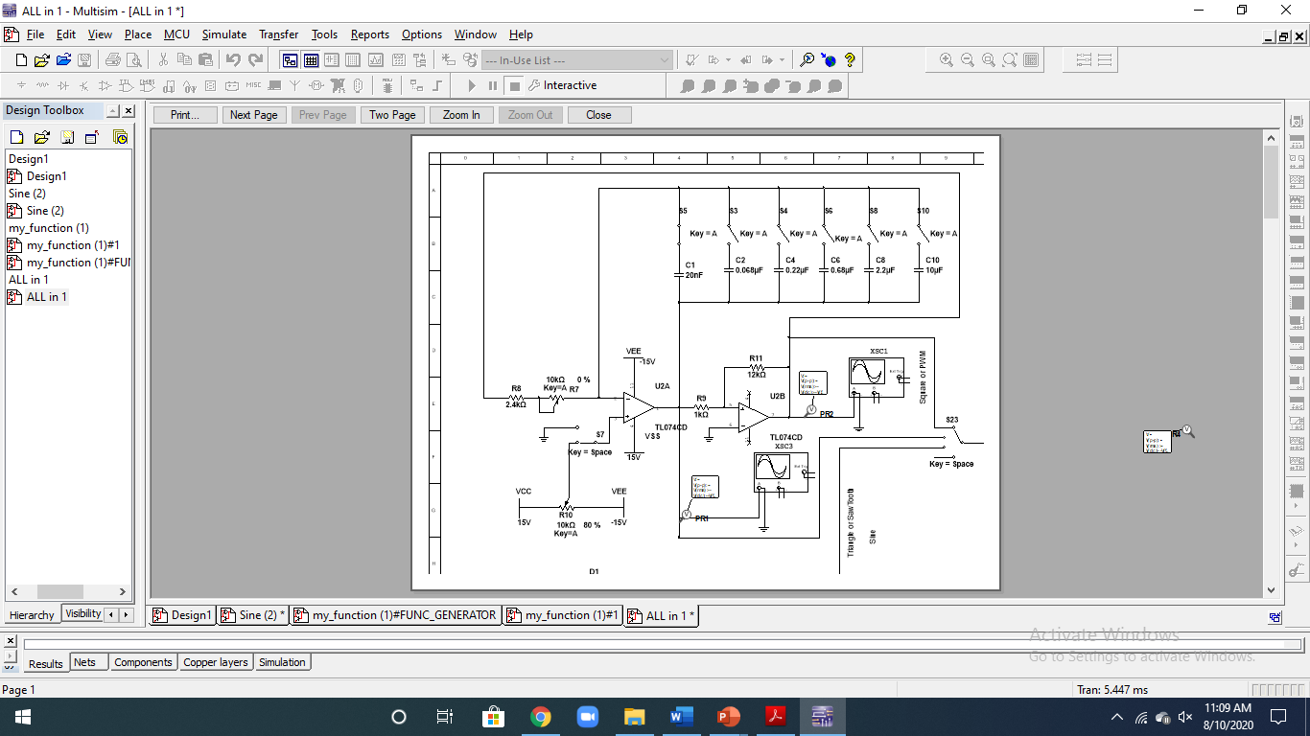

Slide 14
POWER SUPPLY CIRCUIT
+15V and -15V DC power supply
A step-down transformer of 18V, a rectifier bridge and LM7815 and LM7915 regulators are used for this circuit.

Slide 15
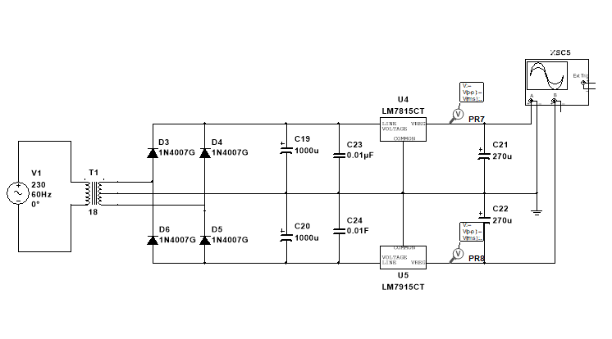

Slide 16
SIMULATION Results

Slide 17
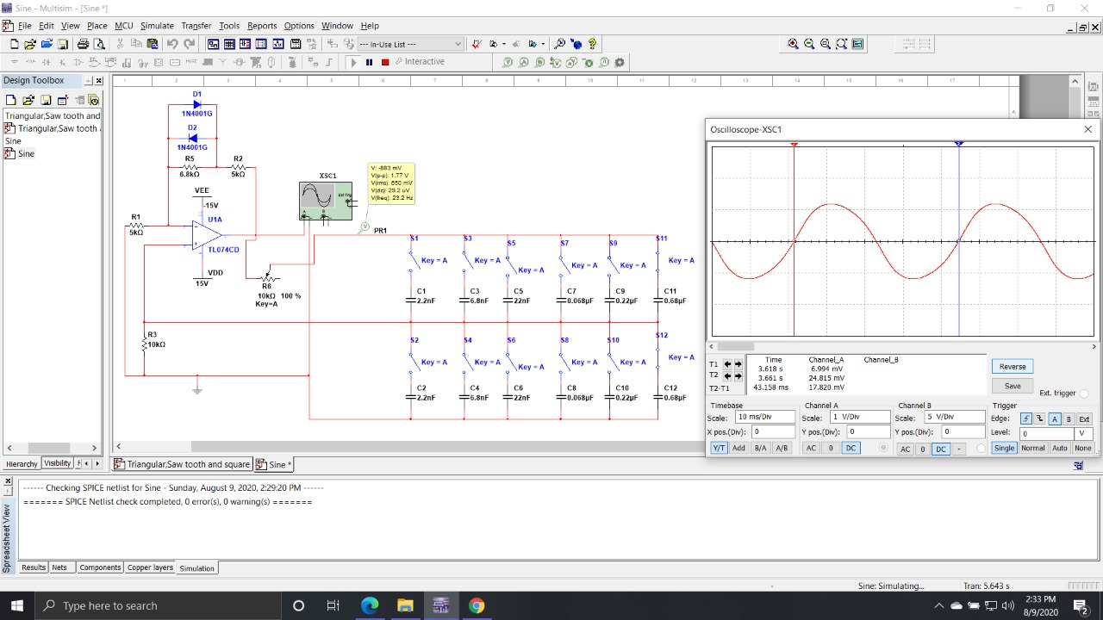

Slide 18
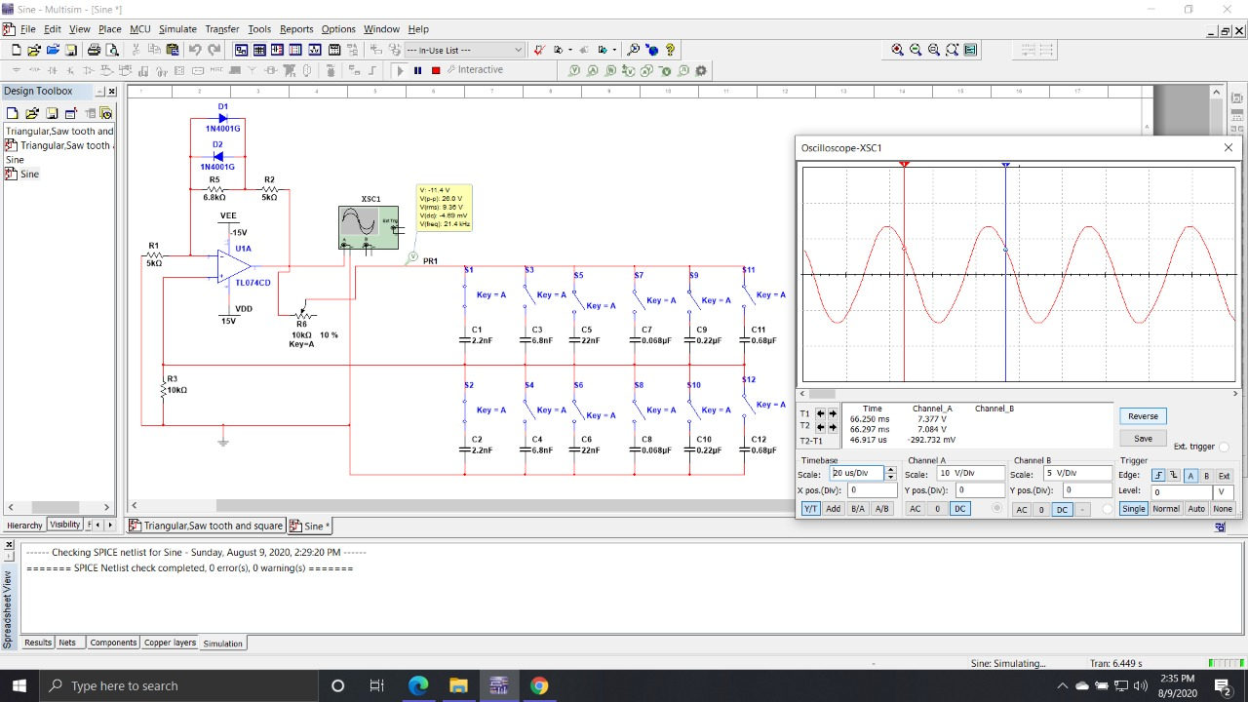

Slide 19
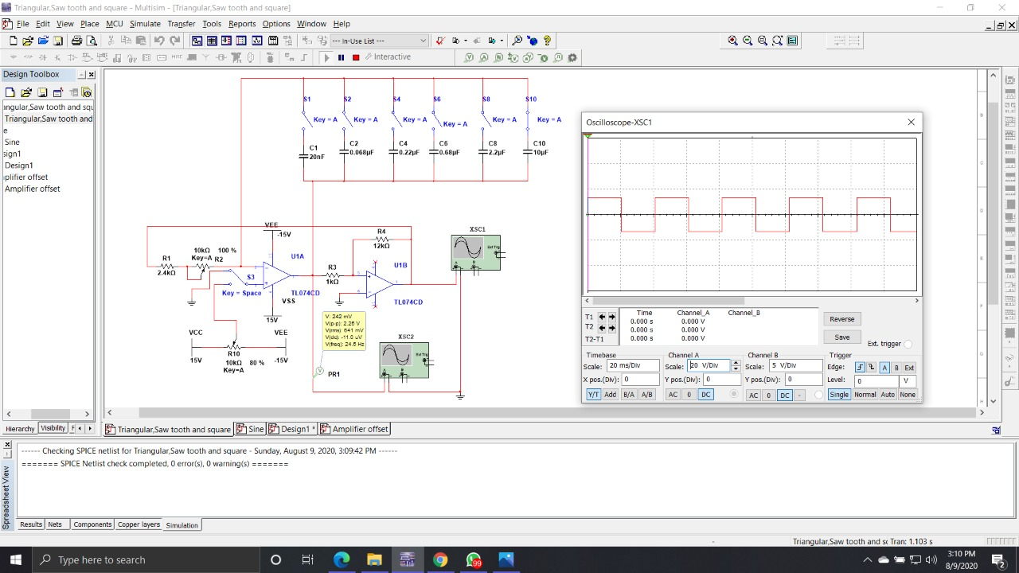

Slide 20
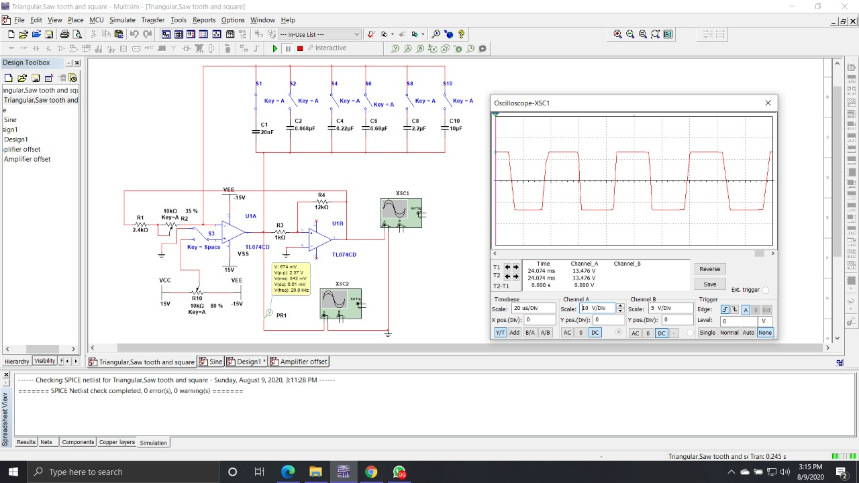

Slide 21
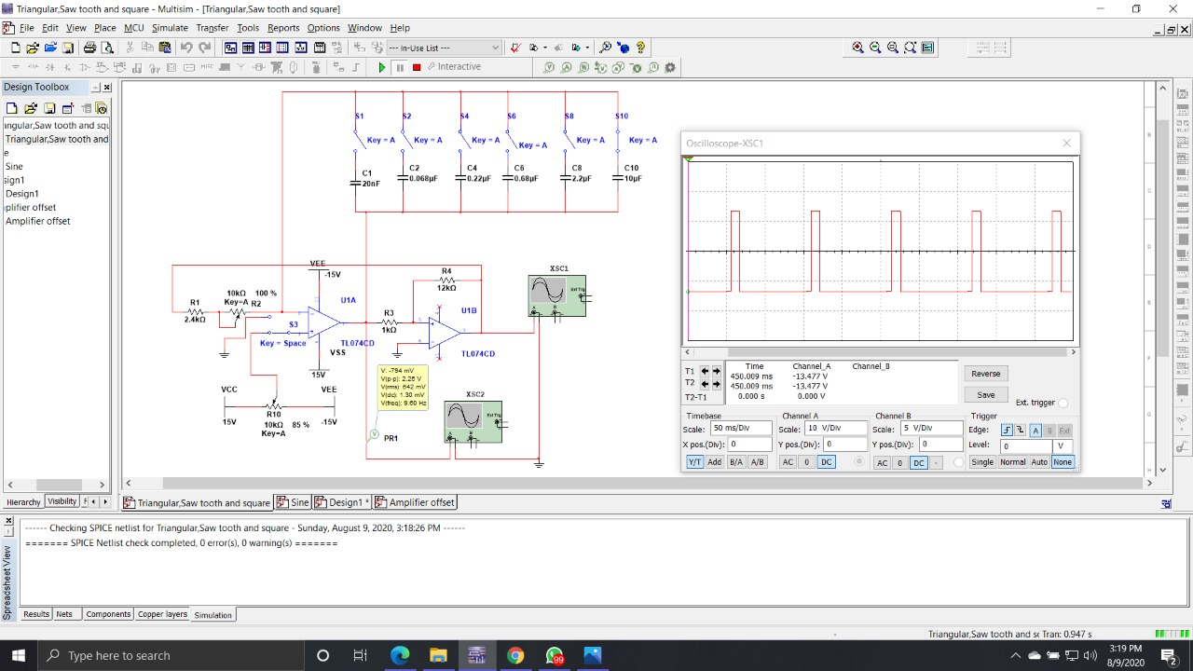

Slide 22
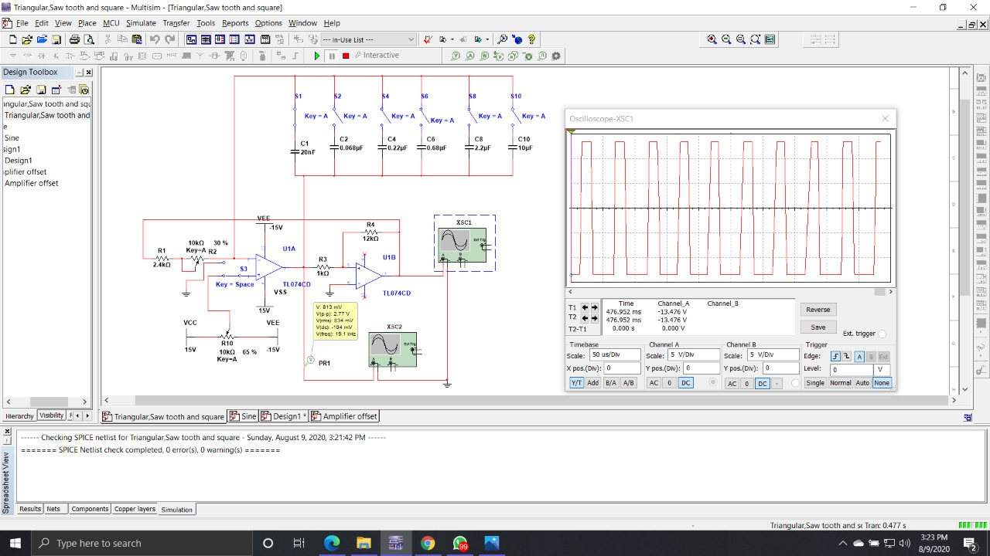

Slide 23
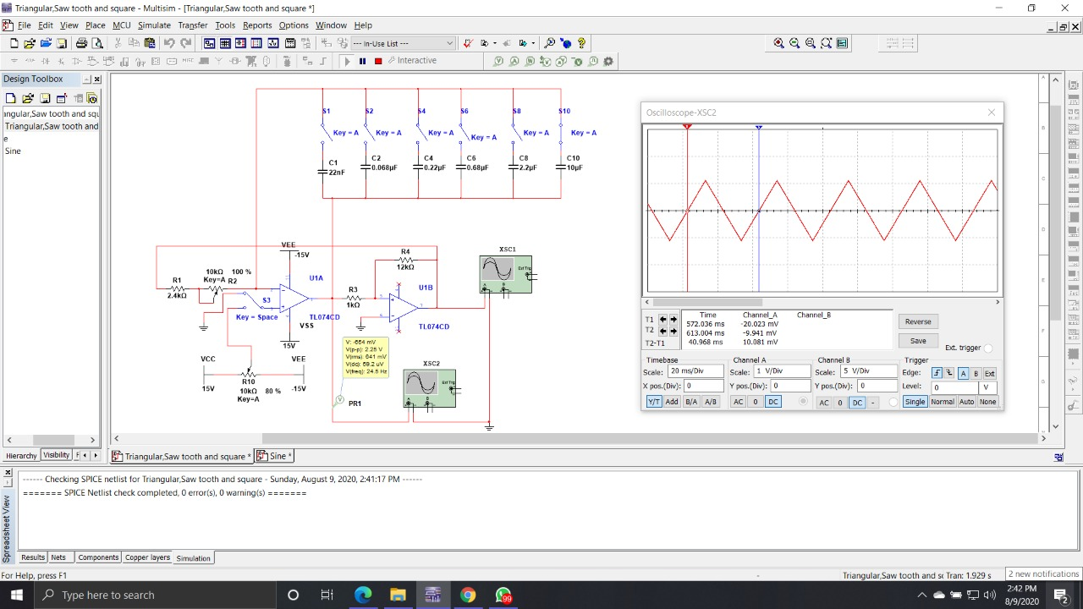

Slide 24
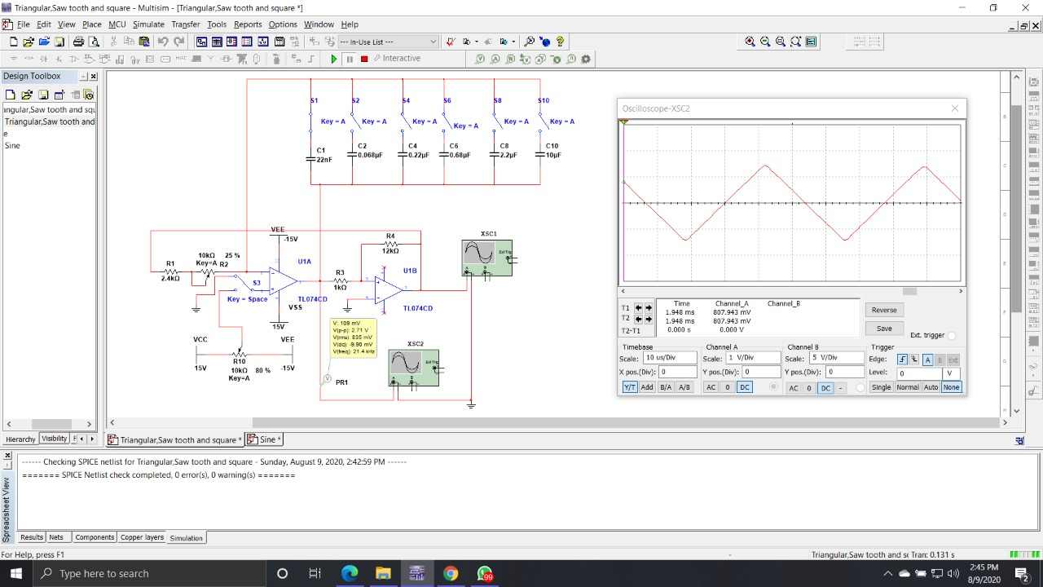

Slide 25
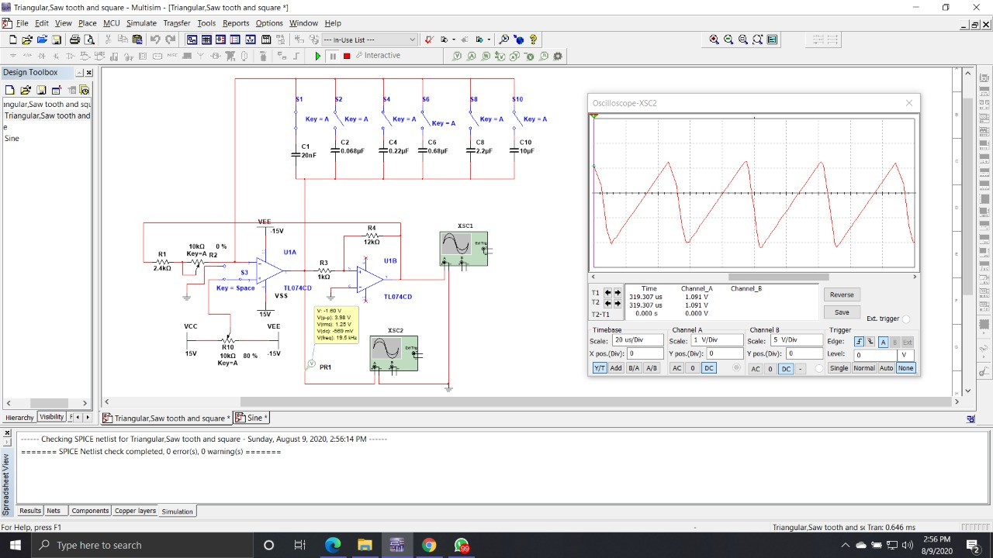

Slide 26
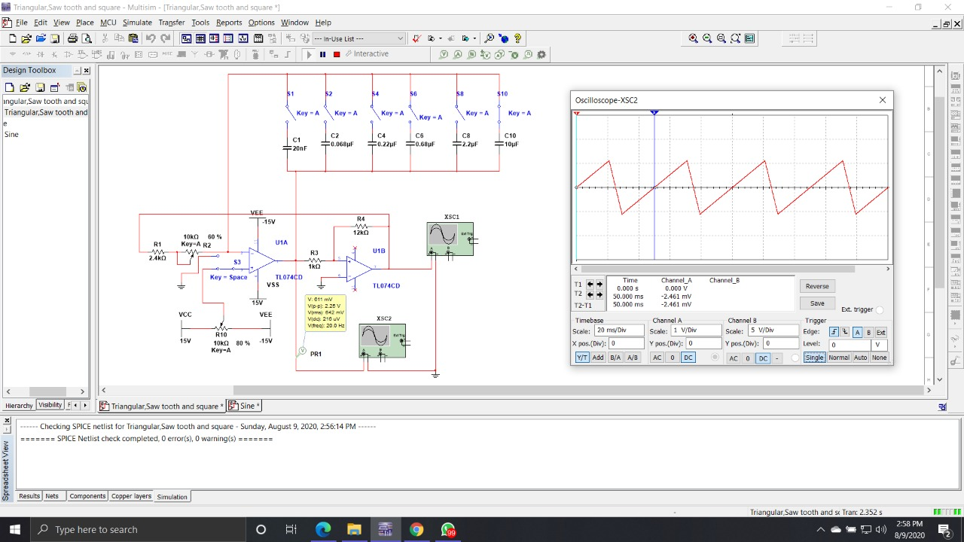

Slide 27
Thank you

